Slide 1

StreamVision Analytics Decoding Netflix's Global Content Strategy Through Data
Girija G
APPLY_175571523468a616a25f680

Slide 2

PROBLEM STATEMENT
Netflix is a leading global OTT streaming platform with diverse movies and TV shows.
The project aims to analyze Netflix’s content catalog trends over 2008-2021.
Focus on understanding distribution of Movies vs TV Shows, genre popularity changes, and country-wise content contributions.
Rising competition demands data-driven insights for strategic content planning.
Goal: Identify strengths, gaps, and recommend future content strategies.

Slide 3
Project Description
Analyze a dataset of 7,789 Netflix records to uncover content trends and audience preferences.
Perform data cleaning, exploratory data analysis, and rich visualizations including genre, country, rating, and temporal trends.
Leverage insights for strategic recommendations on content acquisition and production.
Includes interactive maps and advanced analytics like top directors and growth rate analysis.
Helps Netflix optimize global content mix to maintain market leadership.

Slide 4

WHO ARE THE END USERS?
Netflix content strategists and business analysts for data-driven decisions.
Marketing teams targeting demographic and regional segments.
Content creators and production planners focusing on popular genres and untapped markets.
Investors and stakeholders wanting insight into market trends and growth.
Researchers interested in OTT content evolution and consumption patterns.
Subscribers benefit from improved personalized content and diversified options.

Slide 5

Technology Used
Programming Language: Python
Libraries: Pandas, NumPy (data handling), Matplotlib, Seaborn (data visualization), Plotly (interactive visualizations)
Tools: Jupyter Notebook/Google Colab for interactive analysis
Data Analytics: Exploratory data analysis (EDA), statistical summaries, time series and distribution plots
Mapping: Choropleth maps for global content distribution visualization
Reporting: Markdown for project documentation and insights narratives

Slide 6
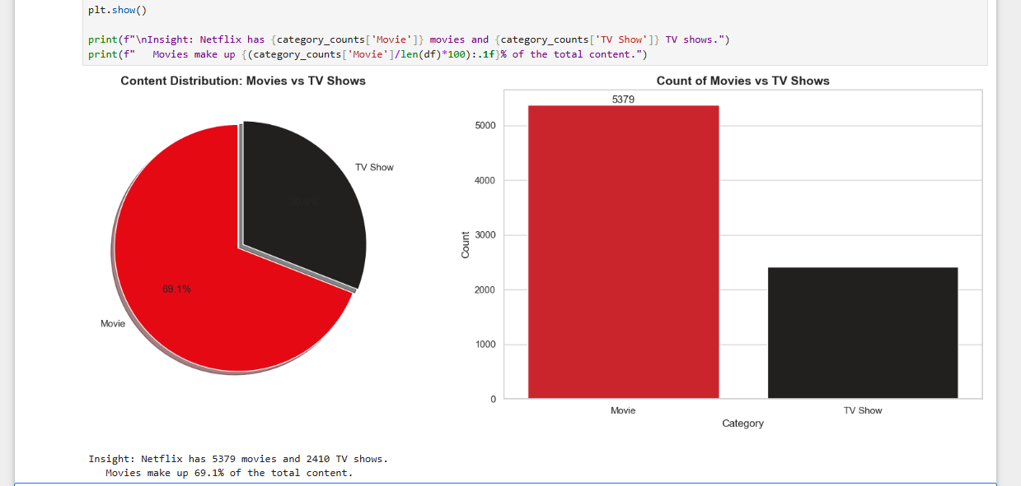
RESULTS1

Slide 7
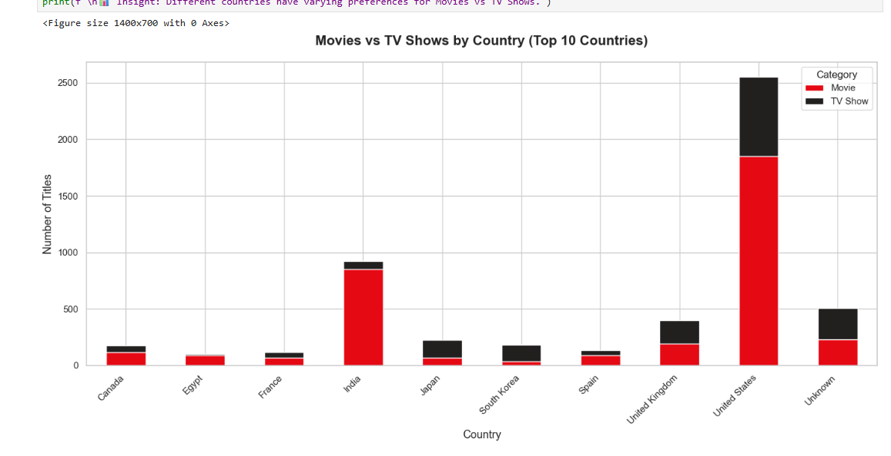
RESULTS2
[Add screen shots of your code or Chart(s) ]

Slide 8
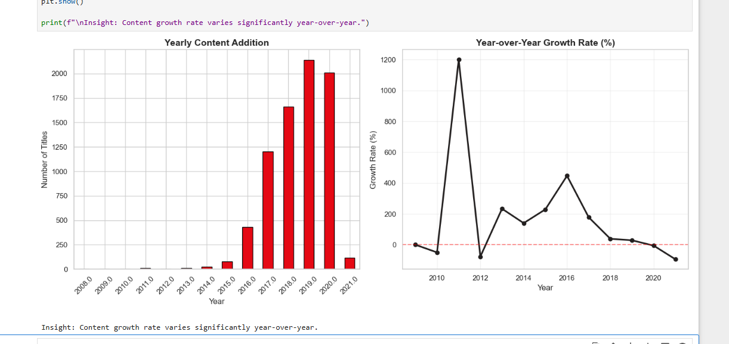
RESULTS3
[Add screen shots of your code or Chart(s) ]

Slide 9
GitHub repository
https://github.com/girijageddavalasa/VOIS_AICTE_Oct2025_MajorProject_GirijaG

Slide 10
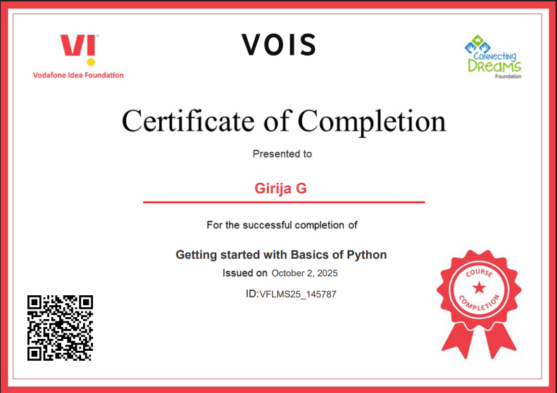
Getting started with Basics of Python Certificate
[Paste your Certificate Here]

Slide 11
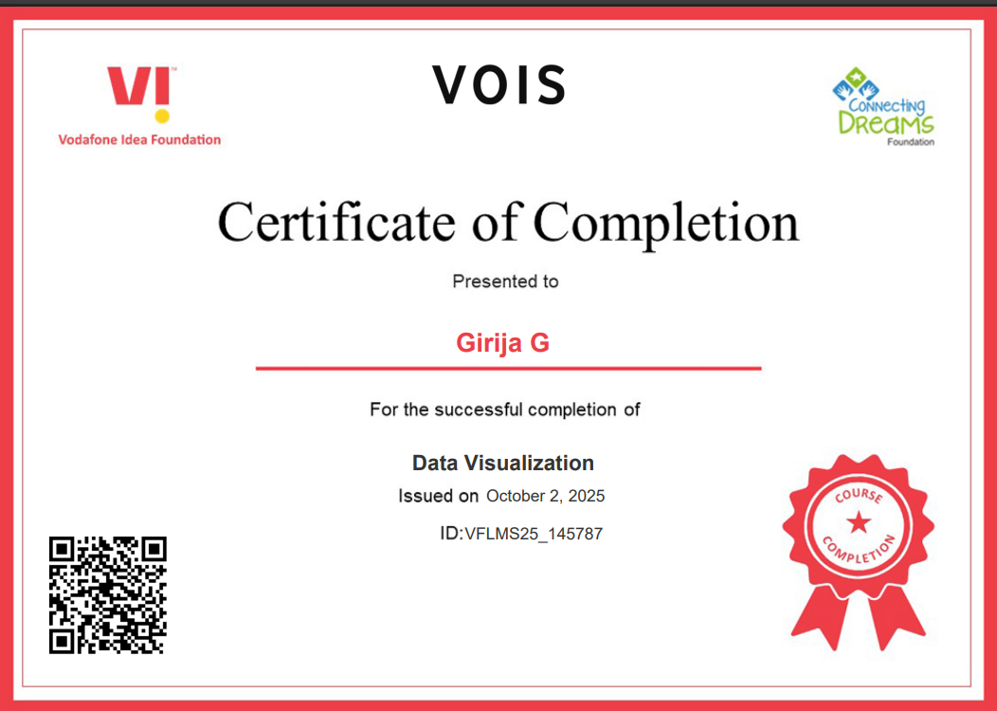
Data Visualization Certificate
[Paste your Certificate Here]

Slide 12
Thank you
.
.

